Slide 1
Understanding the Performance of AI Algorithms in Text-Based Emotion Detection for Conversational Agents
Project Id:
Team Details:
Guide:
Department of computer Science and Engineering
1

Slide 2
Abstract
This project presents a systematic evaluation of AI algorithms for text-based emotion detection in conversational agents. The proposed framework integrates text preprocessing techniques such as data cleaning, tokenization, and feature extraction using word embeddings and contextual representations to effectively handle unstructured textual data. Multiple models, including traditional machine learning classifiers, deep learning architectures, and transformer-based pre-trained language models, are implemented to identify and classify emotions from conversational text. A comparative analysis is conducted using benchmark emotion datasets to examine model robustness and cross-dataset generalization. Performance is evaluated using metrics such as Accuracy, Precision, Recall, F1-score, and confusion matrix analysis to assess both overall effectiveness and class-wise behavior. The results provide insights into selecting the most suitable algorithm for developing reliable, emotion-aware conversational systems that enhance user interaction quality and empathetic response generation.
Department of computer Science and Engineering

Slide 3
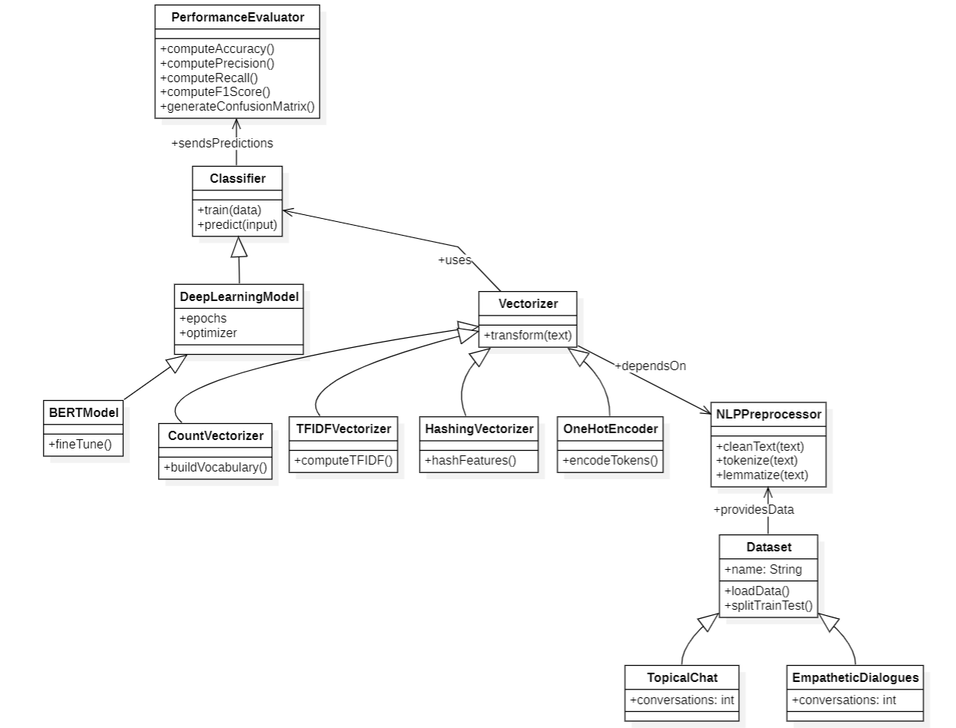
CLASS DIAGRAM

Slide 4
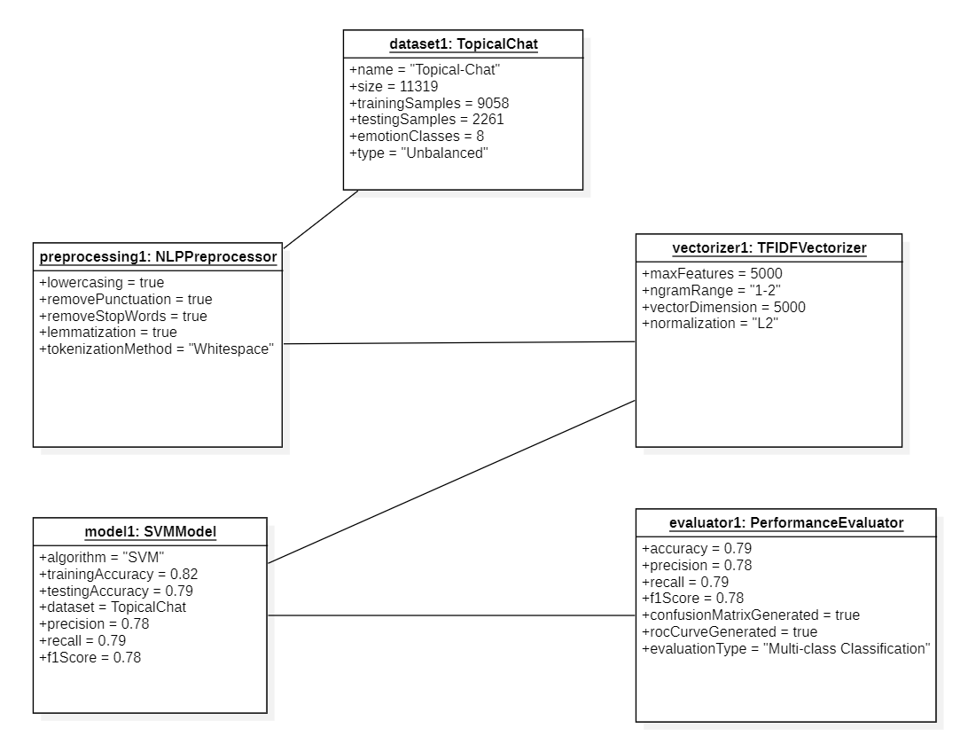
OBJECT DIAGRAM

Slide 5
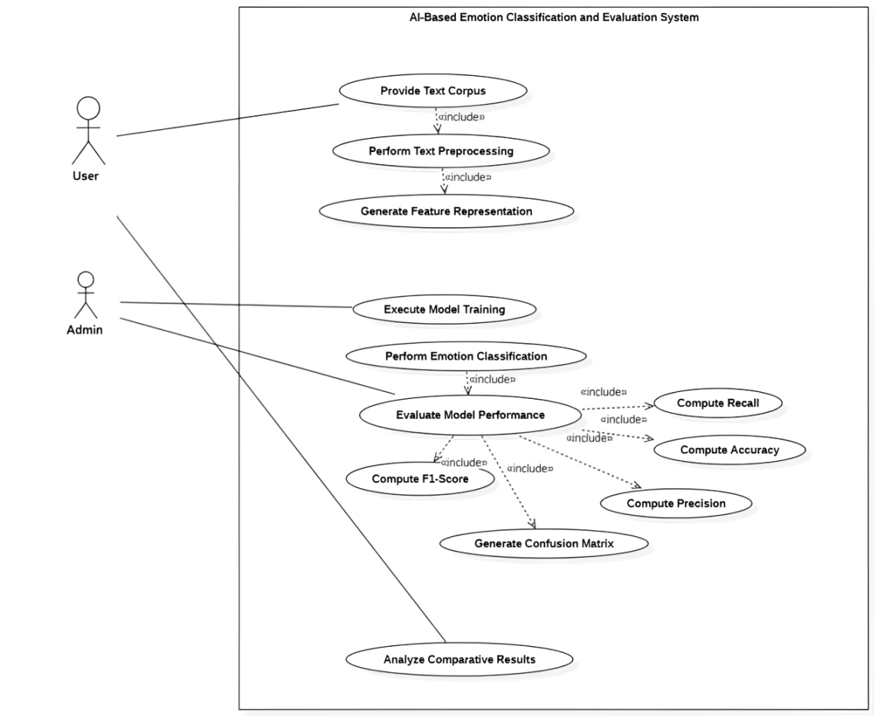
USECASE DIAGRAM

Slide 6
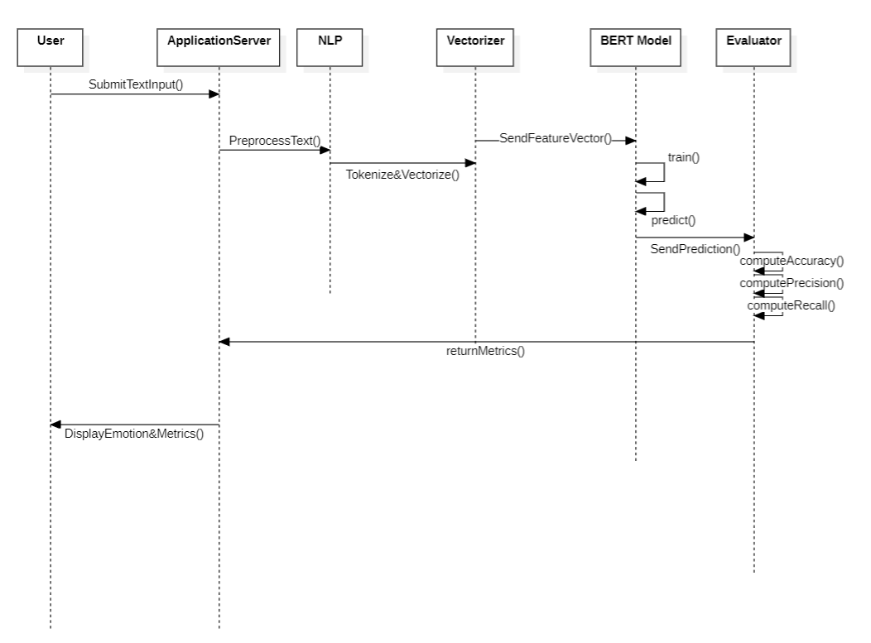
SEQUENCE DIAGRAM

Slide 7
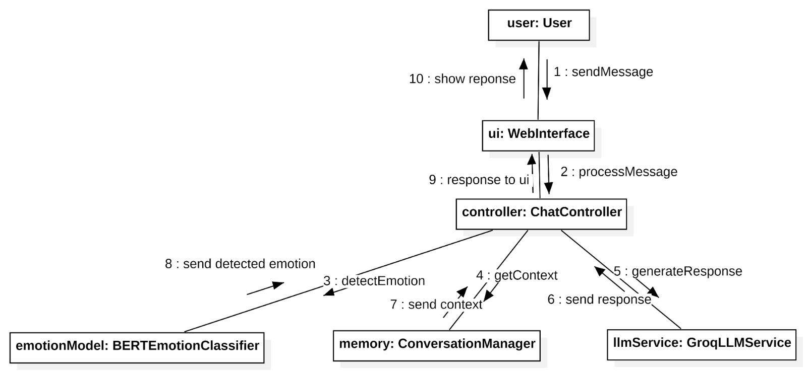
COLLABORATION DIAGRAM

Slide 8
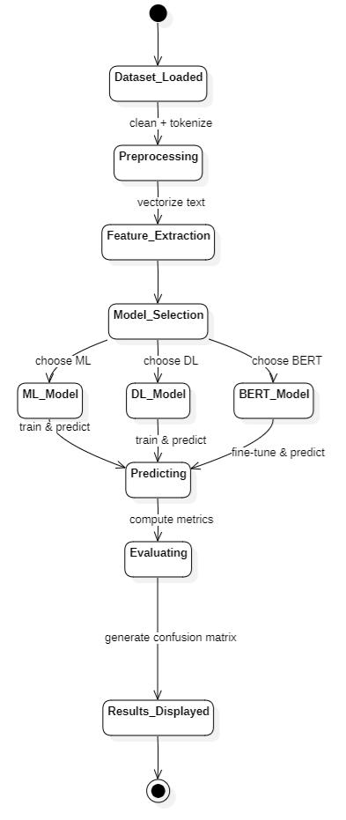
STATECHART DIAGRAM

Slide 9
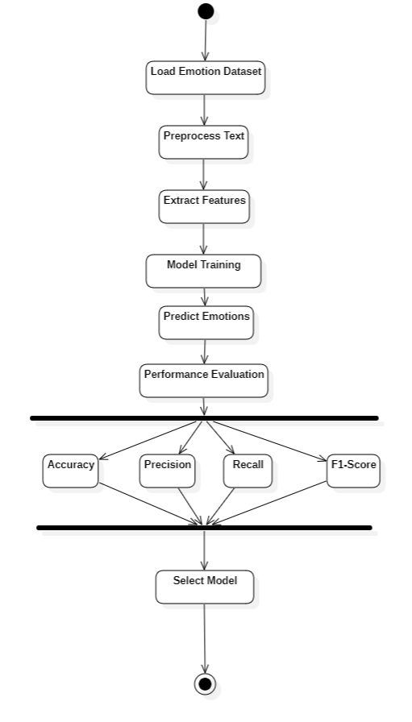
ACTIVITY
DIAGRAM

Slide 10
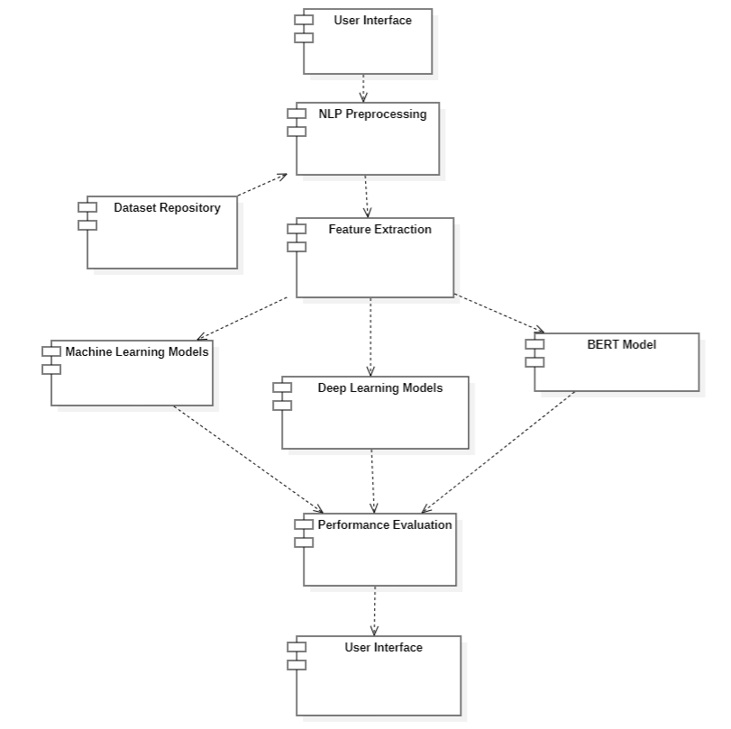
COMPONENT DIAGRAM

Slide 11
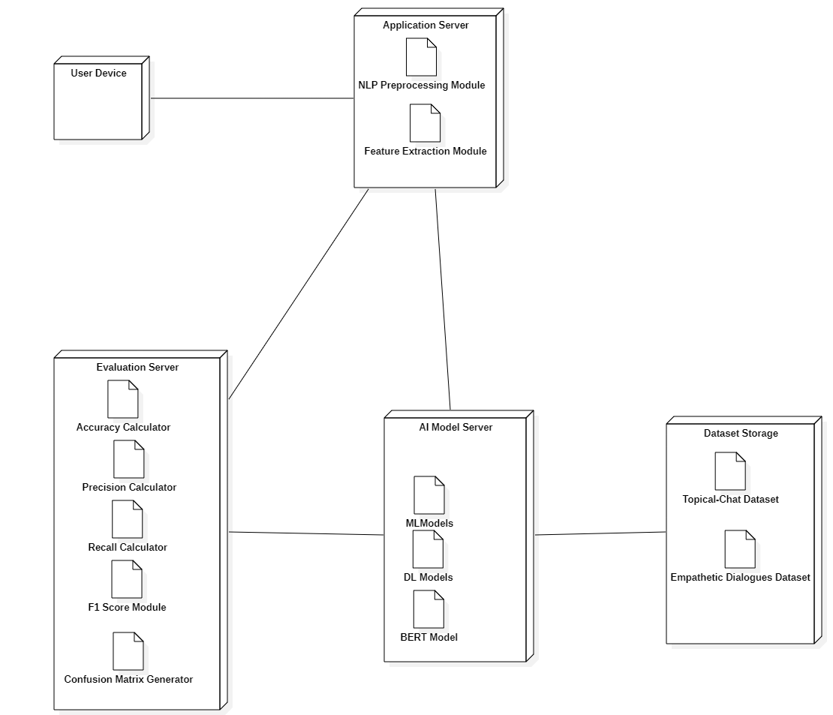
DEPLOYMENT DIAGRAM

Slide 12
THANK YOU

